Slide 1

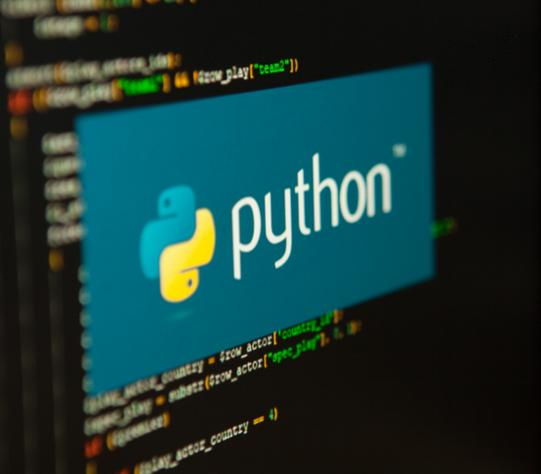

Python…… Explore to Data World
https://www.anaconda.com/download

Slide 2
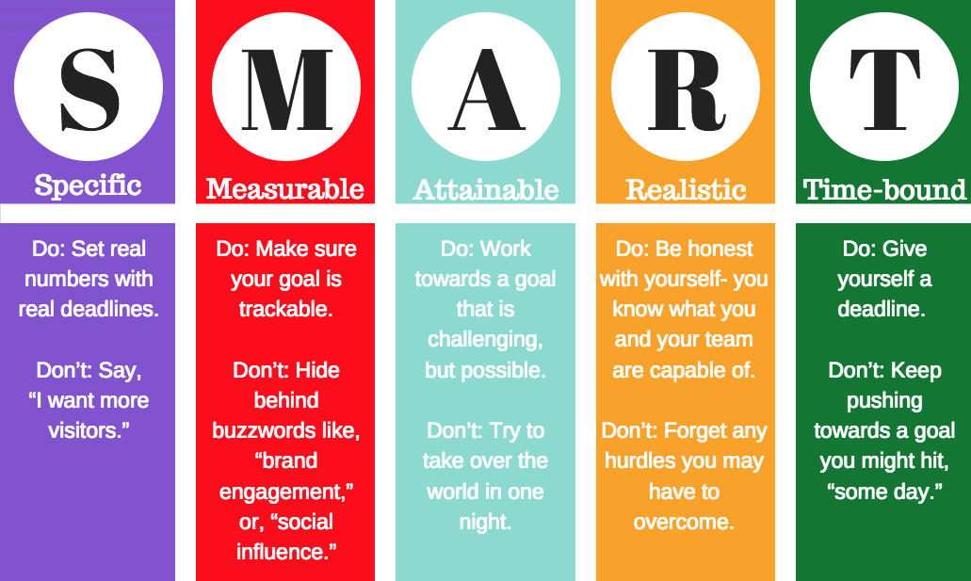
Learning Objectives:
Introduction to Python
Functions
Iterables and Conditional Statement
Modules
Python Strings
Python Dates and Times
Math
File Processing
Exception Handling
OOPS in Python
Playing with Data
NumPy, Pandas, Matplotlib,Seaborn
Data Analysis Using Statistical Models
https://www.anaconda.com/download

Slide 3

Learning Outcomes:
Upon successful completion of this training, participants will be able to:
Write Basic Python Programs
Manipulate Data Structures
Implement Control Flow Logic
Solve Problems with Functions
Handle Errors and Exceptions
Work with Files
Develop Confidence in Writing Python Code
Collaborate with Other Developers
Prepare for Intermediate Python Topics: Lay the foundation for exploring
more advanced topics such as object-oriented programming, libraries, and frameworks used in Python.
https://www.anaconda.com/download

Slide 4
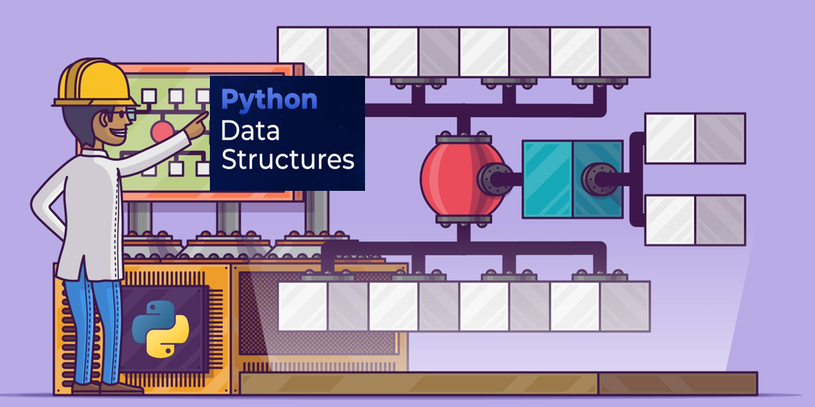

Slide 5
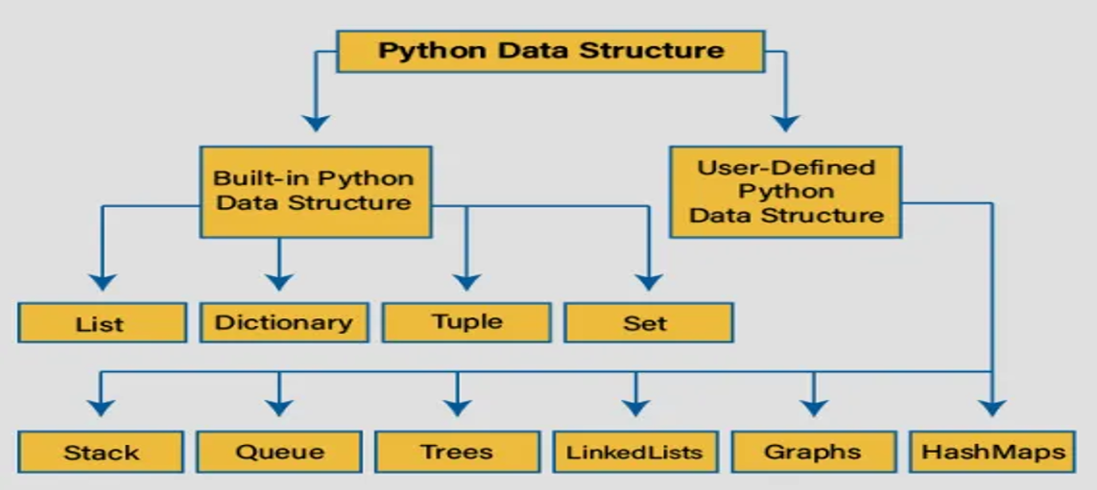

Slide 6
In Python, a tuple is an ordered, immutable collection of items that can store elements of different data types (e.g., integers, strings, floats, or even other tuples). Tuples are defined using parentheses () or sometimes without any delimiters, and items are separated by commas. They are similar to lists but differ in that they cannot be modified after creation, making them useful for protecting data integrity or when immutability is desired.
Key Characteristics of Tuples
Ordered: Items maintain their order, accessible by index (0-based).
Immutable: Once created, elements cannot be changed, added, or removed.
Allows Duplicates: Tuples can contain identical elements.
Heterogeneous: Can store mixed data types.
Lightweight: Tuples are more memory-efficient and faster than lists due to immutability.
1. Creating a Tuple
Tuples are created by enclosing items in parentheses () or by separating items with commas (parentheses are optional in some cases
# Empty tuple
empty_tuple = ()
# Tuple with integers
coordinates = (10, 20, 30)
# Tuple with mixed data types
person = ("Alice", 25, 3.8, True)

Slide 7
# Tuple without parentheses
colors = "red", "green", "blue"
# Single-element tuple (requires a trailing comma)
single = (42,)
# Nested tuple
nested = (1, 2, ("a", "b"), 3)
print(coordinates)
print(person)
print(colors)
print(single)
print(nested)
2. Accessing Tuple Elements: Access elements using indexing (0-based) or slicing to get a subset of the tuple.
Example: Accessing Elements in a Tuple
fruits = ("apple", "banana", "orange", "grape")
# Access by index
print(fruits[0])
print(fruits[-1])
# Slicing
print(fruits[1:3])
print(fruits[:2])
print(fruits[2:])

Slide 8
3. Immutability of Tuples: Tuples cannot be modified after creation, which ensures data integrity but limits operations like adding, removing, or changing elements.
Example: Attempting to Modify a Tuple
point = (5, 10)
point[0] = 15
print(point)
# You can create a new tuple instead
new_point = (15, point[1])
print(new_point)
4. Tuple Methods
Tuples have only two built-in methods due to their immutability:
count(x): Returns the number of occurrences of x.
index(x): Returns the index of the first occurrence of x.
Example: Using Tuple Methods
numbers = (1, 2, 2, 3, 4, 2)
# Count occurrences
print(numbers.count(2))
# Find index of first occurrence
print(numbers.index(2))

Slide 9


Slide 10
1. Which of the following creates a tuple?
A) t = [1, 2, 3] B) t = {1, 2, 3} C) t = (1, 2, 3) D) t = <1, 2, 3>
Answer: C Explanation: Tuples are created using parentheses ( ).

Slide 11
2. Which of the following is immutable in Python?
A) List B) Tuple C) Dictionary D) Set
Answer: B Explanation: Tuples cannot be changed after creation.

Slide 12
3. Which method returns the number of times a value appears in a tuple?
A) find() B) count() C) index() D) len()
Answer: B Explanation: tuple.count(x) → number of occurrences of x.

Slide 13
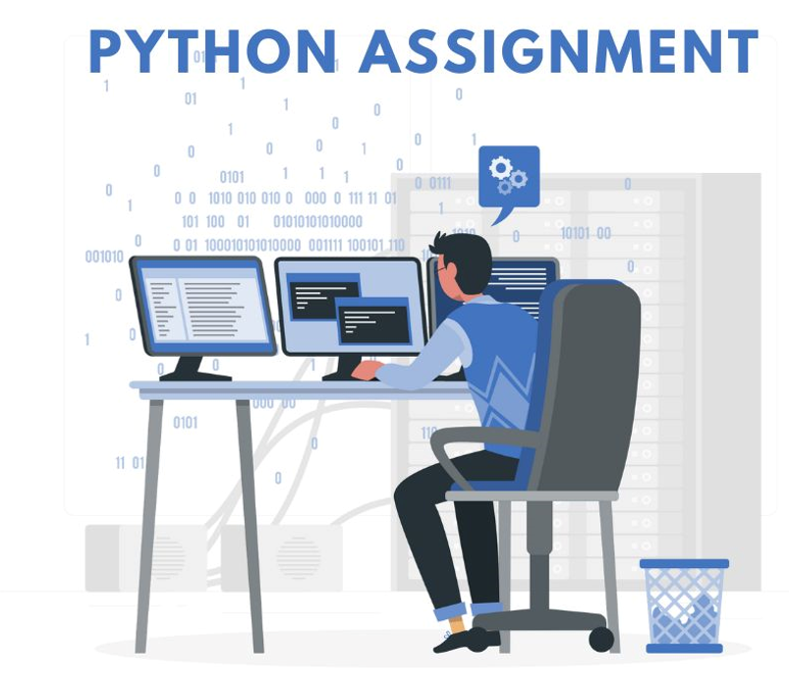

Slide 14
Assignment: Storing Student Records
A tuple to store immutable student records (e.g., name, ID, and GPA) and demonstrates accessing and processing the data.
# Access elements
# List of student tuples
# Calculate average GPA
# Find students with GPA >= 3.7

Slide 15
Examples: Stock Prices calculation Over Time using Lists
Lists to store stock prices for different days or periods. For example, storing daily closing prices of a stock.
# Example: Storing daily closing stock prices for a week
stock_prices = [150.25, 152.30, 149.80, 151.00, 153.75]
# Calculate the average price over the week
average_price = sum(stock_prices) / len(stock_prices)
print("Average stock price for the week:", average_price)
# Find the highest and lowest stock prices
highest_price = max(stock_prices)
lowest_price = min(stock_prices)
print("Highest price:", highest_price)
print("Lowest price:", lowest_price)
→Print the average price rounded to 2 decimal places
print("Average stock price for the week:", round(average_price, 2))

Slide 16
Dictionaries (dict)
An unordered collection of key-value pairs. Keys must be immutable (e.g., strings, numbers, tuples), while values can be any data type.
A dictionary in Python is a built-in data structure that stores data in key-value pairs. Each key in the dictionary must be unique, and it is associated with a value. Dictionaries are mutable, which means you can modify them after they are created.
Syntax: my_dict = {
"key1": "value1",
"key2": "value2",
"key3": "value3"
}
Common Operations:
Access value: my_dict['name']
Add/Update: my_dict['age'] = 26
Remove: del my_dict['age']
Keys: my_dict.keys()
Values: my_dict.values()
Length: len(my_dict)

Slide 17
Key Characteristics of Dictionaries:
Unordered: Dictionaries do not maintain the order of elements (although in Python 3.7+, dictionaries maintain insertion order).
Mutable: You can change, add, or remove key-value pairs.
Indexed by keys: Unlike lists or tuples, which are indexed by position, dictionaries are indexed by keys, and the keys must be unique.
Basic Operations with Dictionaries
Creating a Dictionary:
dict1 = {"name": "Alice", "age": 25, "city": "New York"}
print(dict1)
2. Accessing Values: You can access the value of a dictionary by referring to its key.
print(dict1["name"])
3. Adding or Modifying Elements: You can add new key-value pairs or modify existing ones.
# Modify the existing value
dict1["age"] = 26
# Add a new key-value pair
dict1["email"] = "alice@example.com"
print(dict1)

Slide 18
Removing Elements:
del keyword can be used to remove a key-value pair:
# Removes the key "age"
del dict1["age"]
print(dict1)
pop() removes the key and returns its value:
removed_value = dict1.pop("name") # Removes "name" and stores the value "Alice"
print(removed_value)
clear() removes all elements from the dictionary:
dict1.clear() # Empties the dictionary
print(dict1)

Slide 19
Accessing Keys, Values, and Items:
keys() returns a view of the dictionary’s keys.
print(dict1.keys())
values() returns a view of the dictionary’s values.
print(dict1.values())
items() returns a view of the dictionary’s key-value pairs.
print(dict1.items())
Checking if a Key Exists: You can check if a key exists in a dictionary using in.
if "age" in dict1:
print("Age is present")
else:
print("Missing")

Slide 20
Nested Dictionaries
Dictionaries can also contain other dictionaries, which allows you to represent more complex data structures.
nested_dict = {
"student1": {"name": "Alice", "age": 22},
"student2": {"name": "Bob", "age": 23}
}
# Accessing nested dictionary values
print(nested_dict["student1"]["name"])
Dictionary Comprehension
Just like list comprehensions, you can use dictionary comprehensions to create dictionaries in a concise way.
squares = {x: x**2 for x in range(5)}
print(squares)
Dictionaries in Python are incredibly versatile and widely used for tasks like mapping, counting, grouping, and representing structured data.

Slide 21
4. Sets
A set is an unordered collection of unique elements. It is similar to a list or dictionary, but it does not allow duplicate elements and does not maintain any specific order.
Syntax: my_set = {1, 2, 3}
Common Operations:
Add element: my_set.add(4)
Remove element: my_set.remove(2)
Union: my_set | {5, 6}
Intersection: my_set & {1, 3, 5}
Length: len(my_set)
Key Characteristics of Sets:
Uniqueness: Sets automatically remove duplicate elements. If you try to add a duplicate element, it will be ignored.
Unordered: The elements in a set are not indexed, and their order is not guaranteed.
Mutable: You can add or remove elements from a set after its creation.
No indexing, slicing, or other sequence-like behavior: Since sets are unordered, you cannot access elements by index.

Slide 22
Basic Set Operations:
1. Creating a Set: You can create a set using the set() constructor or curly braces {}.
# Using curly braces
my_set = {1, 2, 3, 4, 5}
print(my_set)
# Using set() constructor
another_set = set([1, 2, 3, 4, 5])
print(another_set)
2. Adding Elements: You can add individual elements to a set using the add() method.
my_set.add(6)
print(my_set)
3. Removing Elements: You can remove elements using remove() or discard() methods. The remove() method raises a KeyError if the element is not found, while discard() does not.
# Removes 3, raises KeyError if 3 is not found
my_set.remove(3)
# Removes 4, but does not raise an error if 4 is not found
my_set.discard(4)
print(my_set)

Slide 23
4. Set Operations (Union, Intersection, Difference, Symmetric Difference):
Sets in Python support many mathematical set operations like union, intersection, difference, etc.
Union (| or .union()): Combines all elements from both sets.
Intersection (& or .intersection()): Returns common elements.
Difference (- or .difference()): Returns elements that are in the first set but not in the second.
Symmetric Difference (^ or .symmetric_difference()): Returns elements that are in either set but not in both.
set_a = {1, 2, 3}
set_b = {3, 4, 5}
# Union
print(set_a | set_b)
# Intersection
print(set_a & set_b)
# Difference
print(set_a - set_b)
# Symmetric Difference
print(set_a ^ set_b)

Slide 24
5. Checking Membership: You can check if an element exists in a set using the in keyword.
print(3 in my_set)
print(7 in my_set)
6. Iterating Over a Set: You can iterate over a set using a for loop, but note that the order is not guaranteed.
for elem in my_set:
print(elem)
7. Set Comprehensions: You can create sets using comprehensions, similar to list comprehensions.
squares = {x ** 2 for x in range(5)}
print(squares) # {0, 1, 4, 9, 16
# Example: Finding unique elements between two lists

Slide 25
# Example: Finding unique elements between two lists
list_a = [1, 2, 3, 4, 5, 5, 6]
list_b = [4, 5, 6, 7, 8]
# Convert lists to sets to remove duplicates
set_a = set(list_a)
set_b = set(list_b)
# Union of both sets
unique_elements = set_a | set_b
print(unique_elements)

Slide 26
List comprehensions
Basic Syntax
[expression for item in iterable]
# Square numbers
squares = [x**2 for x in range(10)]
# Convert to uppercase
words = ['hello', 'world', 'python']
upper_words = [word.upper() for word in words]
With Condition (Filtering)
# Even numbers only
evens = [x for x in range(20) if x % 2 == 0]
# Words longer than 4 characters
long_words = [word for word in words if len(word) > 4]

Slide 27
If-Else Conditions
# Replace negative numbers with 0
numbers = [1, -2, 3, -4, 5]
non_negative = [x if x >= 0 else 0 for x in numbers]
# Even/Odd classification
classification = ['even' if x % 2 == 0 else 'odd' for x in range(5)]
Nested Loops
# Matrix flattening
matrix = [[1, 2, 3], [4, 5, 6], [7, 8, 9]]
flattened = [num for row in matrix for num in row]
# Cartesian product
colors = ['red', 'green']
sizes = ['S', 'M', 'L']
combinations = [(color, size) for color in colors for size in sizes]

Slide 28
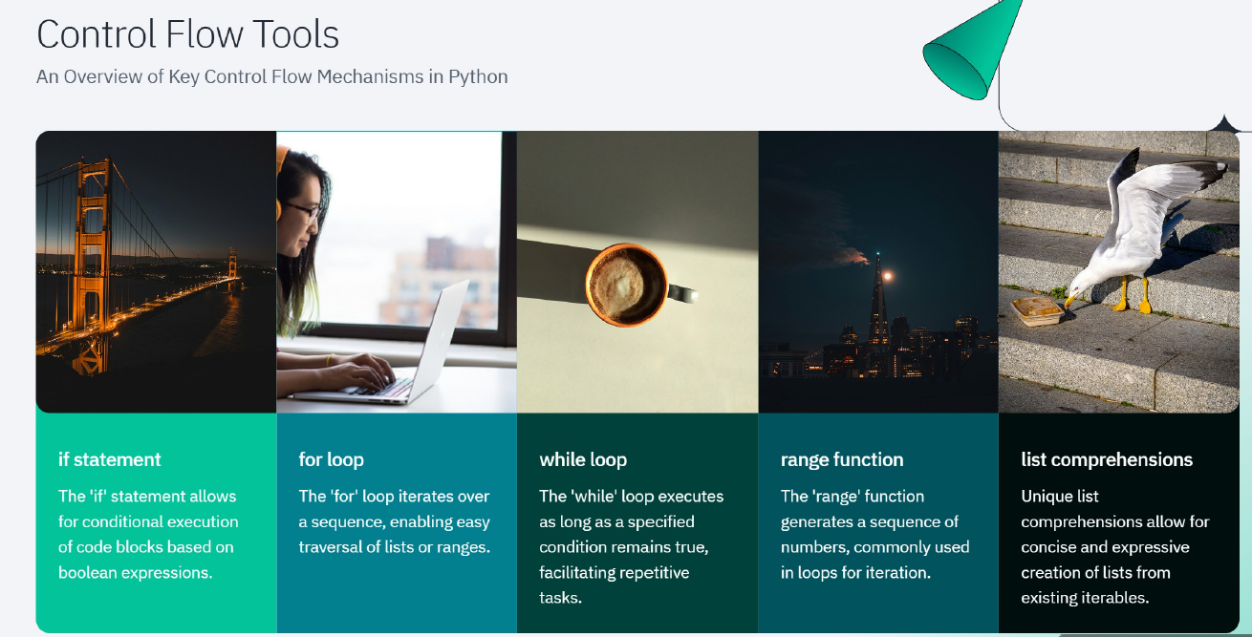

Slide 29
Selection or Conditional Statement
Selection in Python is made using the two keywords ‘if’ and ‘elif’ and else (elseif)
# Student Grading System and Get the student's score as input
score = float(input("Enter the student's score (0-100): "))
# Check if the score is valid (between 0 and 100)
if score < 0 or score > 100:
print("Invalid score! Please enter a score between 0 and 100.")
elif score >= 90:
print("Grade: A - Excellent!")
elif score >= 80:
print("Grade: B - Very Good!")
elif score >= 70:
print("Grade: C - Good!")
elif score >= 60:
print("Grade: D - Pass!")
else:
print("Grade: F - Fail!")

Slide 30
Iteration
As the name suggests it calls repeating things again and again. We will use the most popular ‘for’ loop here.
# Python program to illustrate a simple for loop
for step in range(5):
print(step)
# Using a for loop to iterate through a list
fruits = ['apple', 'banana', 'cherry', 'date']
for fruit in fruits:
print(fruit)
# Using a while loop to iterate until a condition is met
count = 0
while count < 5:
print("Count is:", count)
count += 1

Slide 31
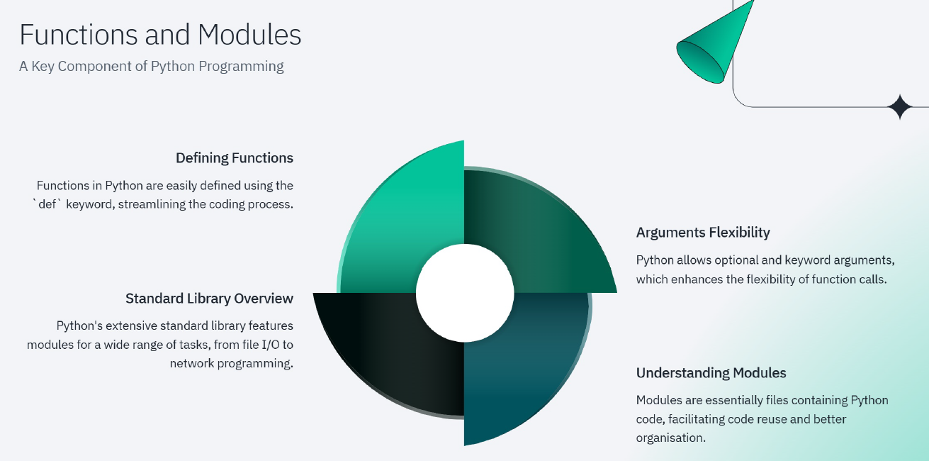

Slide 32
Functions
Functions like a bunch of code that is intended to do a particular task in the whole Python script. Python used the keyword ‘def’ to define a function.
Syntax:
def function-name(paramters):
#function body
# Python program to illustrate functions
def hello():
print("hello")
print("hello again")
hello()
# calling function
hello()

Slide 33
# Conditional Statement Program
var = 100
if ( var == 100 ):
print("The number is equal to 100")
if var % 2 == 0:
print("The number is even")
else:
print("The given number is odd")
elif var == 0:
print("The given number is zero")
else:
print("The given number is negative")

Slide 34
Module
Python has a very rich module library that has several functions to do many tasks.
‘import’ keyword is used to import a particular module into your python code. For instance consider the following program.
# Python program to illustrate math module
import math
print ("Square root of 100:", math.sqrt(100))

Slide 35
# Conditional Statement Program
marks = 80
result = ""
if marks < 30:
result = "Failed"
elif marks > 75:
result = "Passed with distinction"
else:
result = "Passed"
print(result)
# Iteration Program
words = ["one", "two", "three"]
for x in words:
print(x)
# Iteration Program
i = 1
while i < 6:
print(i)
i += 1

Slide 36
Jump Statements
The jump statements are used to jump on a specific statement by breaking the current flow of the program. In Python, there are two jump statements break and continue.
The break Statement
It terminates the current loop and resumes execution at the next statement.
x = 0
while x < 10:
print("x:", x)
if x == 5:
print("Breaking...")
break
x += 1
print("End")

Slide 37
The continue Statement
It skips the execution of the program block and returns the control to the beginning of the current loop to start the next iteration.
for letter in "Python":
# continue when letter is 'h'
if letter == "h":
continue
print("Current Letter :", letter)

Slide 38
Problem Statement : Define stock data as a tuple with stock symbol, price per share, and number of shares
Example : Create for (Stock Symbol, Price per Share, Number of Shares)
# Format: (Stock Symbol, Price per Share, Number of Shares)
portfolio = (
('AAPL', 150.0, 10), # Apple stock: $150 per share, 10 shares
('GOOGL', 2800.0, 5), # Google stock: $2800 per share, 5 shares
('AMZN', 3400.0, 2), # Amazon stock: $3400 per share, 2 shares
('TSLA', 650.0, 15) # Tesla stock: $650 per share, 15 shares
)
# Function to calculate total value of the portfolio
def calculate_portfolio_value(portfolio):
total_value = 0
for stock in portfolio:
symbol, price_per_share, num_shares = stock
stock_value = price_per_share * num_shares
total_value += stock_value
print(f"Stock: {symbol}, Value: ${stock_value:.2f}")
return total_value
# Calculate and display the total portfolio value
total_value = calculate_portfolio_value(portfolio)
print(f"\nTotal Portfolio Value: ${total_value:.2f}")

Slide 39
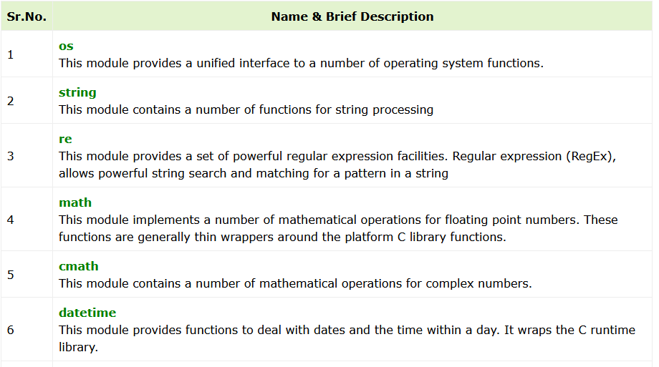
Python Built-in Modules
Below are few listed

Slide 40
Python User-defined Modules
Any text file with .py extension and containing Python code is basically a module. It can contain definitions of one or more functions, variables, constants as well as classes. Any Python object from a module can be made available to interpreter session or another Python script by import statement. A module can also include runnable code.
Creating a Python Module
Creating a module is nothing but saving a Python code with the help of any editor. Let us save the following code as mymodule.py
def SayHello(name):
print ("Hi {}! How are you?".format(name))
return
You can now import mymodule in the current Python terminal.
>>> import mymodule
>>> mymodule.SayHello(“Welcome to Python World")

Slide 41
Python - Application Areas
Data Science
Machine Learning
Web Development
Computer Vision and Image processing
Embedded Systems and IoT
Job Scheduling and Automation
Desktop GUI Applications
Console-based Applications
CAD Applications
Game Development

Slide 42
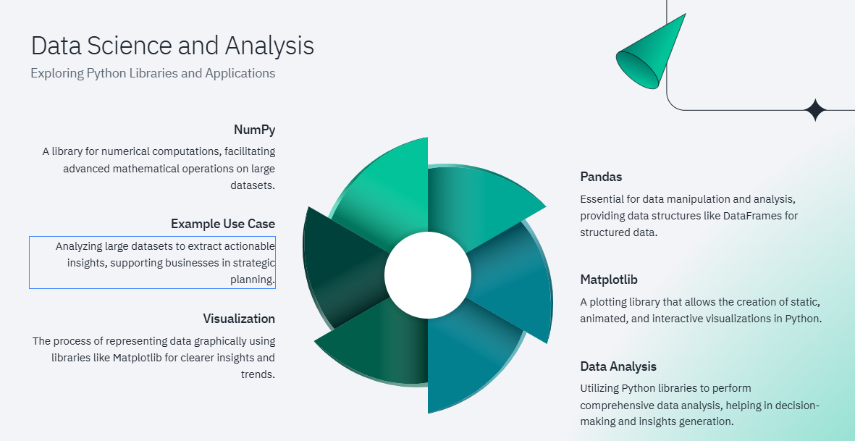

Slide 43
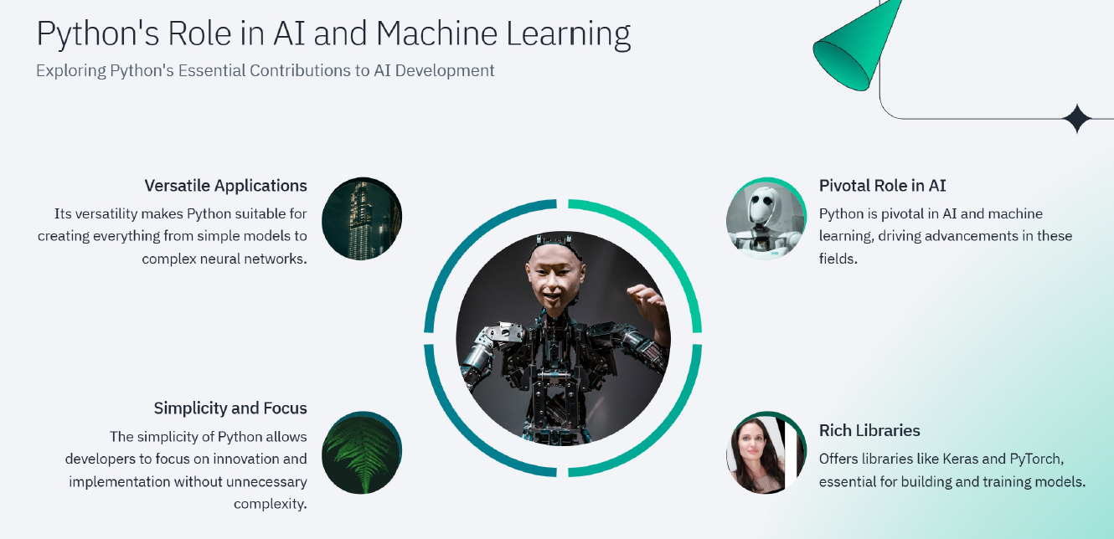

Slide 44
